Slide 1
NLP Based Analysis of SweCris to understand the dynamically changing trends in Research Fund distribution
IP Summer Sem 2023
Guide: Dr. N Arul Murugan
Acknowledgement: K. Sibin
Students: Arha Samanta & Abhishek Acharya

Slide 2
Introduction
Dataset: Swecris is a national database, where you can see how the participating research funding bodies have distributed their funds to researchers in Sweden. The database contains data from both governmental and private research funding bodies – 11 in total. Swecris is administered by the Swedish Research Council on behalf of the Government.

Slide 3
Aim
The aim of our Project is to interact with the Swecris API and get the current database. From this database, we utilize NLP techniques to gather useful information about the most popular topics across various domains. This will be extremely helpful for young researchers as they choose which study fields to focus on for their academic and research careers.

Slide 4
Methodology
The implementation fetches data from SweCris API, performs analysis on project titles and abstracts, and analyzes disease-related information. It identifies the most common words, top 10 words for each funding year, and plots graphs to visualize trends and patterns over time.
Additionally, it examines words before and after specific keywords like 'disease', 'virus', and 'infection' to find any discernible patterns.

Slide 5
Work Done
Here, we extended the work of K. Sibin by identifying the top 10 most relevant words from both the Title and Abstract of the data. The analysis of the Title proved more insightful, yielding conclusive results. We manually removed common words from the Abstract to obtain relevant words.
Additionally, we conducted an analysis of the most common diseases over the years, identifying trends by counting their occurrences. Furthermore, we extracted words preceding and following 'disease', 'virus', and 'infection', providing valuable data for further processing and analysis.

Slide 6
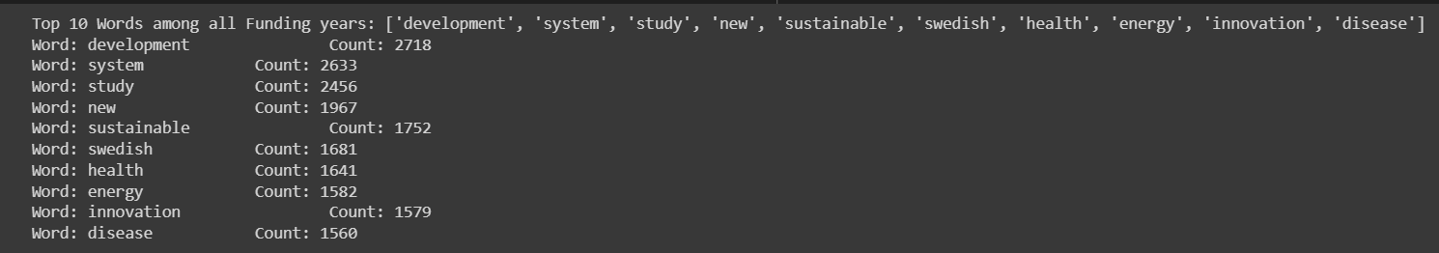
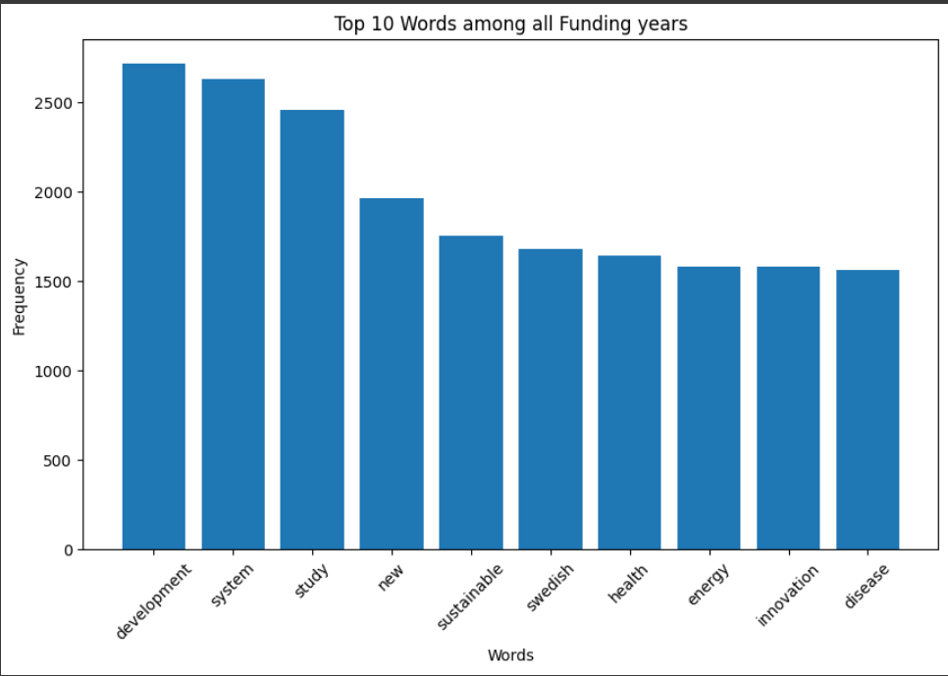
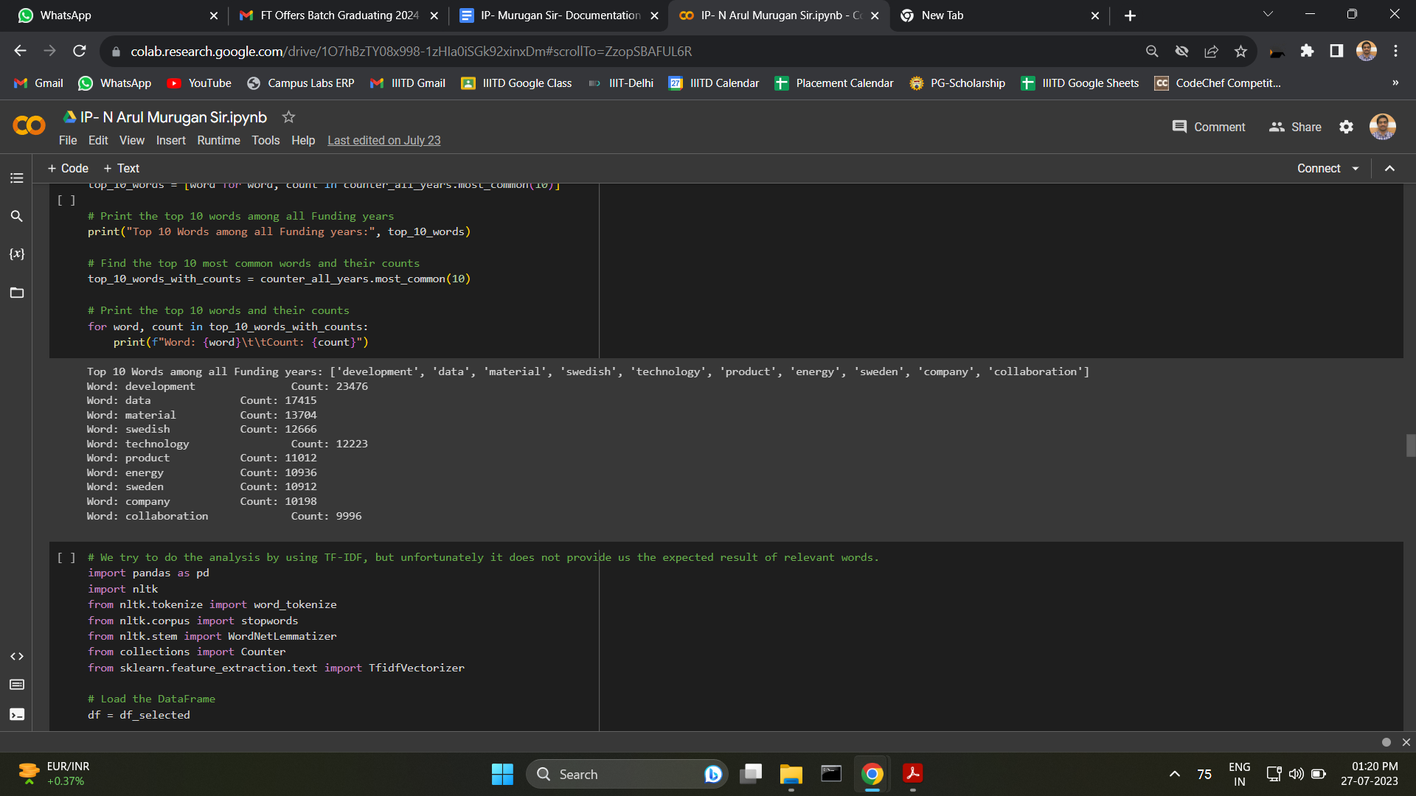
Results

Slide 7
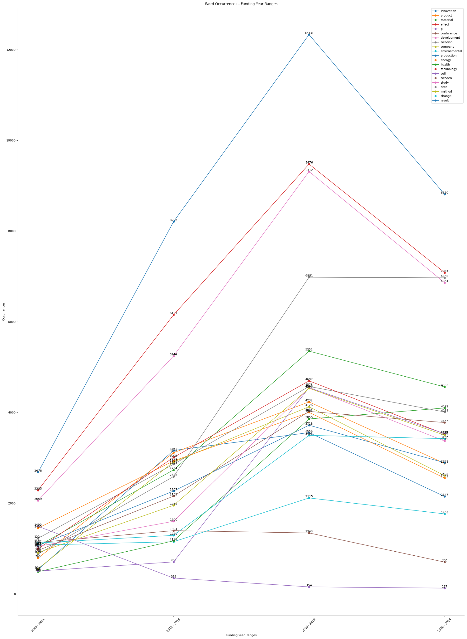
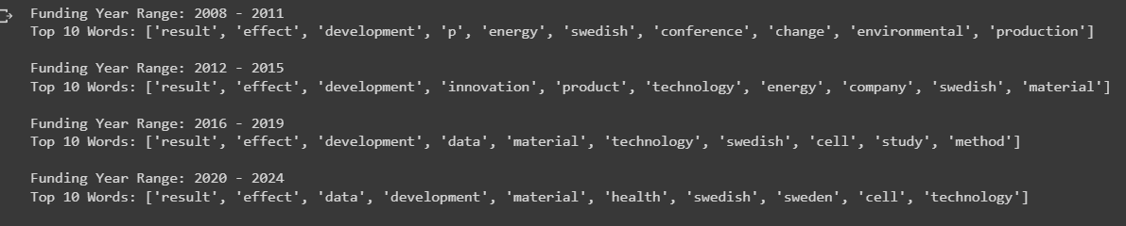
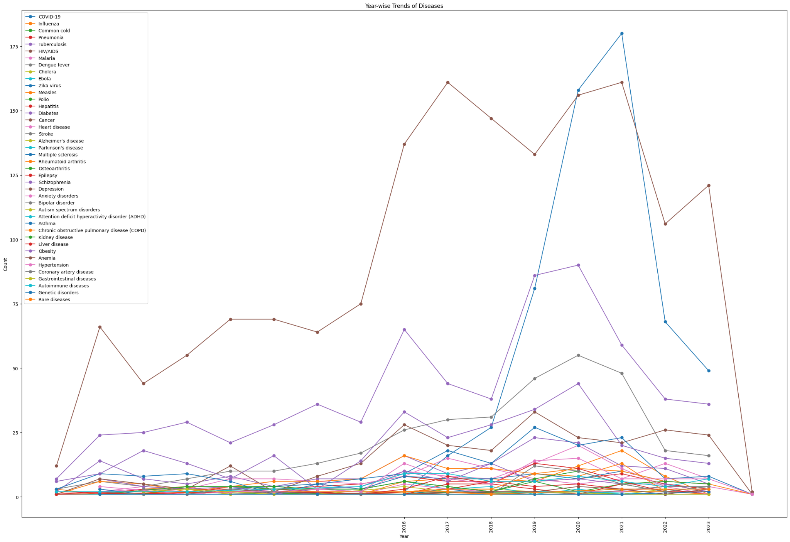
Results(Contd.)

Slide 8
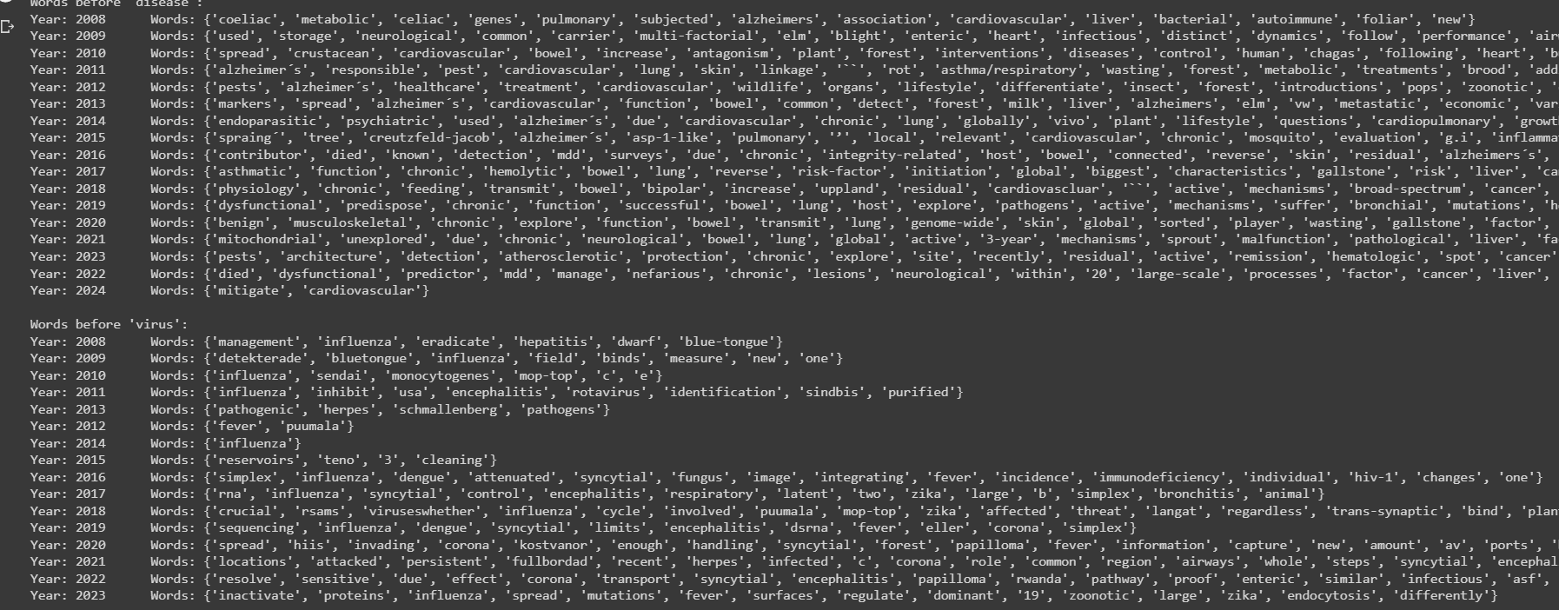
Results(Contd…)

Slide 9
Individual Contributions
Arha Samanta | Abhishek Acharya
Interacted with SweCris API and extracted the dataset. Preprocessed the dataset. Designed the various year wise bins, and grouped the dataset into them, for analysis. Tried to do TF-IDF analysis on Project Abstract, but not found to be of much help. Found the most common diseases. | Fetched the top 10 words from Title. Extracted only most relevant top 10 words from Abstract, not all. Plotted all the relevant graphs. Analysed the diseases by their occurrence count and plotted their graph. Extracted words before and after the words: 'disease', 'virus' and 'infection'.

Slide 10
Conclusion
In conclusion, the analysis of research projects using SweCris API has provided valuable insights into various aspects of the data. By exploring project titles and abstracts, we were able to identify the most common and relevant words across different funding years. This allowed us to gain an understanding of the prevailing research trends and topics over time.
Overall, this analysis has contributed to a deeper understanding of the research landscape and has the potential to assist researchers, institutions, and funding bodies in making informed decisions. The approach of combining data analysis, NLP techniques, text processing, and data visualization has proven to be a powerful method for extracting valuable insights from this complex dataset.

